Slide 1
Relativity Forms APIs

Slide 2



Kevin Opperman
Adam Sorna
Keith Kaminski
Justin Dougherty
Notes:
Good morning everyone, my name is Justin Dougherty and I am a product manger at Relativity. I have the pleasure of being joined by three masters of engineering Kevin Opperman, Adam Sorna, and Keith Kaminski.
S: You are here today because you want to learn more about the Relativity Forms API.
C: That said, we want to call out up from that this is going to be a session geared for engineers. Now somehow I have weaseled my way into this session, but rest assured, I will step aside shortly, and let the grown ups speak.
I: So while we will be highlighting the benefits of Relativity Forms, we are going to be spending the majority of our time diving deep into the code and architecture.
P: We are going to talk about what Relativity Forms is, how it works, and walk through some examples of how Relativity Forms can be used in practice.
A: So as we go through the session today, consider how you will be able to leverage Relativity Forms in your own applications.
B: We hope at the end of our time today, you will walk out of here excited about Relativity Forms and are eager to work this into your applications.

Slide 3
Relativity Forms Overview
Relativity Forms Technology Changes
Deeper Into Relativity Forms
Example: RDO Conversion
Q & A

Slide 4
Product Overview
Relativity Forms is our new layout rendering engine with first class JavaScript APIs.
Why is it important?
Integration with our design system
Part of our overall strategy to modernize our architecture
Better development experience
Notes:
Relativity Forms is our new layout rendering engine that is powered by first call Javascript APIs that empower engineers to quickly and easily make modifications to the UI.
Why is this important…
If you attended the key note presentation, you saw our chief product office Chris Brown share designs for the our new Aero Ui. This new UI will be driven by a Design System that we will be rolling out next year. Relativity Forms was created from the building blocks of the design system, and
Show Edit and View mode (we need to decide on a new name for View perhaps)
SPA-based architecture for rendering Forms in the browser. Covers View/Edit pages.
Does it not also cover “Create” pages?
Speak to the availability, what release and versions have this available.
Highlight that the goal for this was not specifically enhance the UI. The goal was to change the architecture.
43 PAs in “View” (read-only) mode, and the Views backing item lists.
Single location of consolidate UI components and styles
Accelerates feature development, enables design system options
Future component and style hub for the next generation UI
Journey to the Cloud
Load balancing of web servers
Increased availability and stability
Stability across releases (use API instead of DOM so no breaking changes)
Greatly expand API coverage for the product (we created lots of new APIs this year)
Easier to build and test customizations
Built on a modern technology stack (takes advantage of HTML 5, etc…)

Slide 5
Relativity Object Model Fundamentals
Object Type
Field
Field
Field
Field
Field
Layout
View
Relativity Forms
Relativity List
Notes:
TODO: Make this not so ugly. Perhaps add animations.
Adam wants to expound on View” As in “View” (read-only) mode, and the Views backing item lists. Should we update this to show Forms have a View and Edit mode?

Slide 6
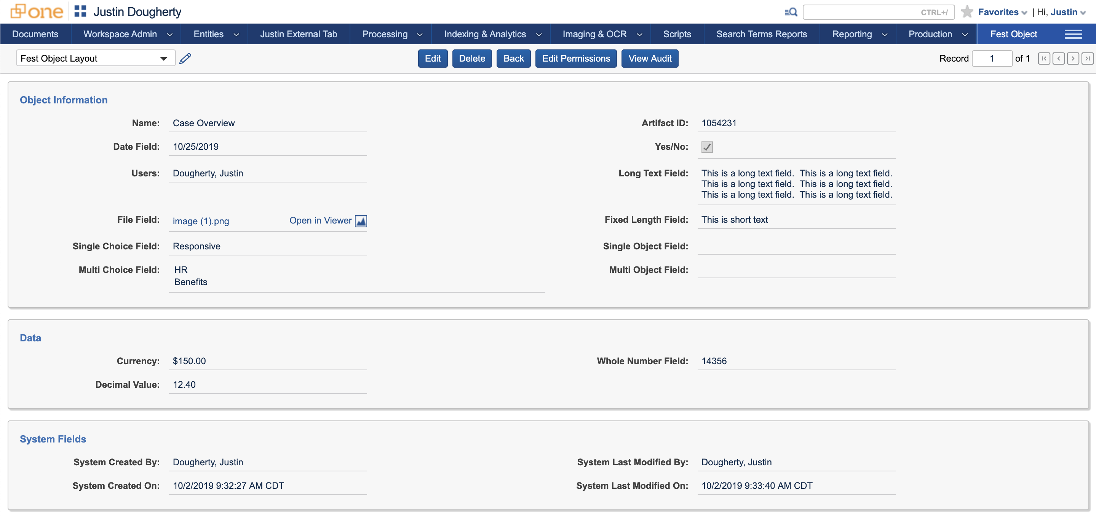
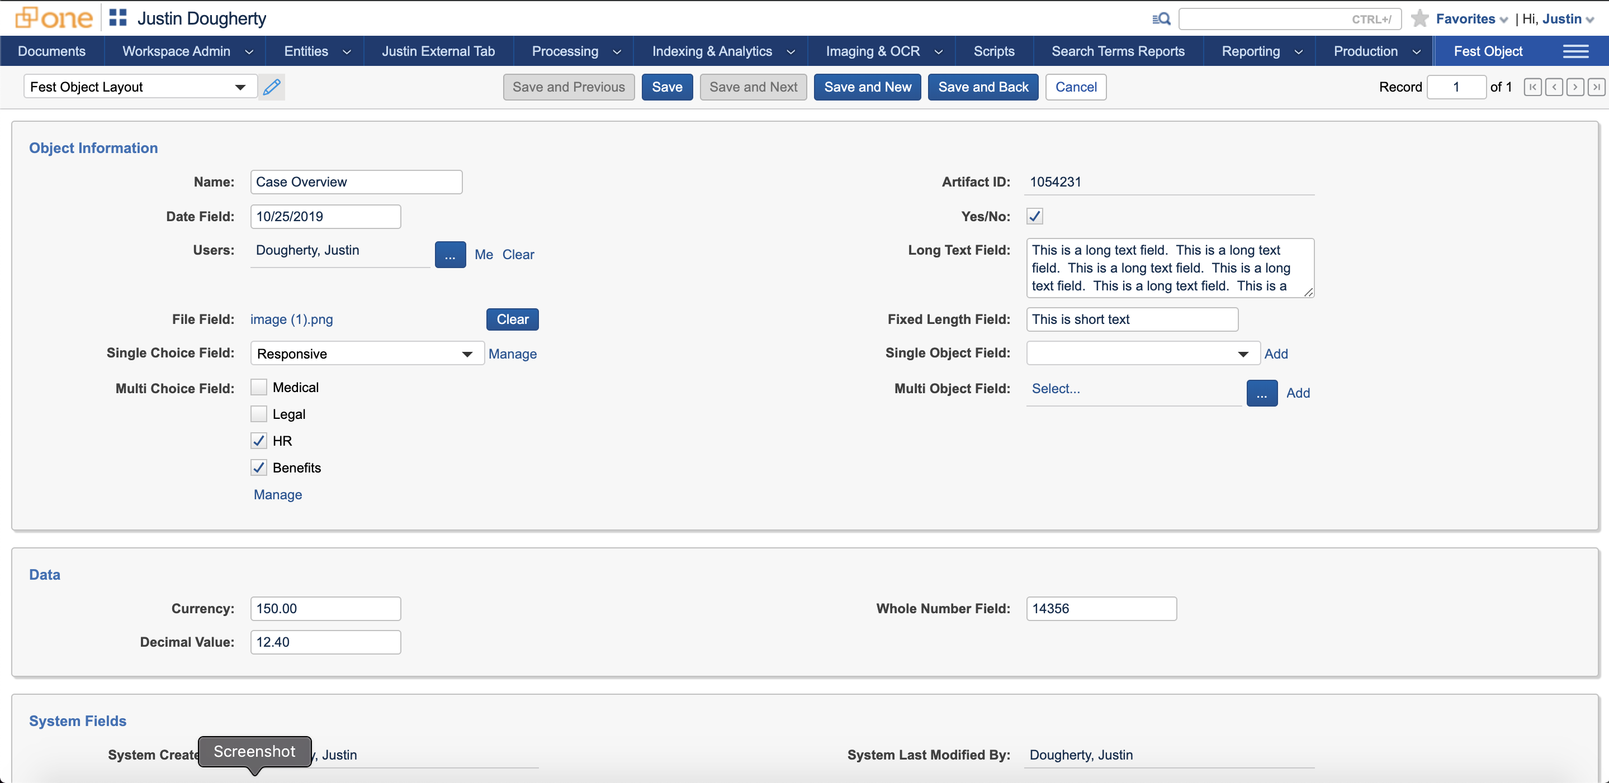
Relativity Forms
Notes:
Point out:
Has an Edit and View mode.
Looks very similar to Classic – but has a few new enhancements. Would be good to point out one-or two. Example (not sure if this is true or not) "The date/time fields have been broken up so that dates and times are in separate elements."

Slide 7
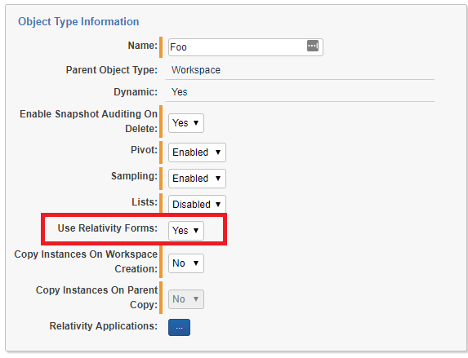
Toggling Relativity Forms
New property on Object Type: Use Relativity Forms
Default behavior controlled by DefaultUseRelativityFormsValue Instance Setting. Its default value is false.

Slide 8
What's different about Relativity Forms?
Built with a Single Page Application architecture
More interactive user experience
Introduction of Relativity Forms API
Changes to Event Handlers that modify the UI
Page Interaction Event Handlers are created and are loaded differently
Console Event Handlers do not fire. Consoles are created from within PIEH.
Various other changes
Many enhancements to improve the look-and-feel of the page
Notes:
Type ahead filtering in droplist fields (including layout selector droplist).
Save and Previous button in the action bar.
Possibility to add new object within Multiple Object Field (Classic supported this feature for Single Object fields only).
Advanced filtering is available in child lists in the same way as in List Page.
Relativity Forms are 508/WCAG compliant.
The framework needed for multiple language support is now in place for the UI.

Slide 9
Will you need to update your Application to support Relativity Forms?
No
Your application only uses built-in features available to a forms page
Layouts still drive the display of the page and all Layout elements are supported, including child lists
All action bar actions are fully functional out-of-the-box – buttons, changing layouts, etc…
Object Rules are respected
Your application uses only the following Event Handlers on your Object Types:
PreLoad, PreSave, PostSave, PreDelete
Yes
Your application contains use Console or Page Interaction Event Handlers
Your layouts include HTML-enabled or Layout Text fields and they modify content elsewhere on the page
You use PreLoad Event Handlers to supply default values.
You display messages with HTML or JavaScript content as part of PreLoad/PreSave/PostSave Event Handlers
You use the RedirectToLayout PostExecuteAction.
Notes:
It attempts to hide the stateless nature of the web from developers. This is great for quick development, but you end up fighting the framework when you need to optimize your code.
See if we can reduce the amount of verbiage on this page.

Slide 10
Relativity Forms Technology Changes

Slide 11
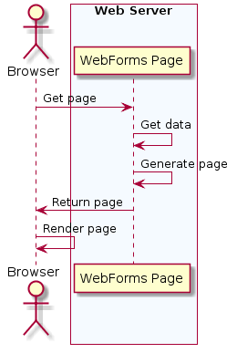
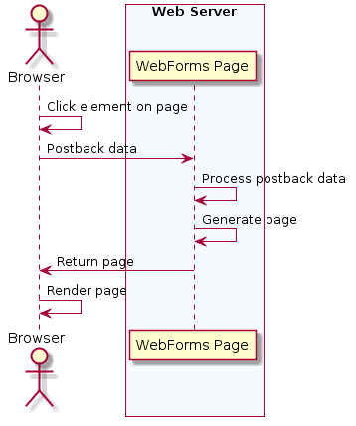
Classic Forms Architecture
Page Startup
User Activity
Notes:
@startuml
actor "Browser" as Browser
box "Web Server" #F5FAFF
participant "WebForms Page" as FFA
== Page Startup ==
Browser->FFA: Get page
FFA -> FFA: Get data
FFA -> FFA: Generate page
FFA->Browser: Return page
end box
Browser->Browser: Render page
== User Activity ==
Browser -> Browser: Click element on page
Browser -> FFA: Postback data
FFA -> FFA: Process postback data
FFA -> FFA: Generate page
FFA->Browser: Return page
Browser->Browser: Render page
@enduml

Slide 12
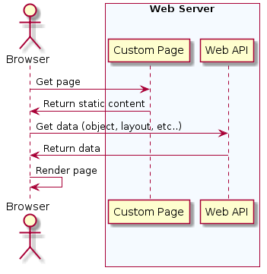
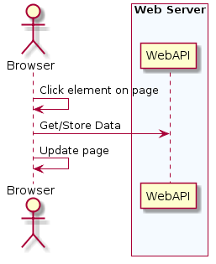
Relativity Forms Architecture
Page Startup
User Activity
Notes:
@startuml
actor "Browser" as Browser
box "Web Server" #F5FAFF
== Page Startup ==
participant "Custom Page" as FFA
participant "Web API" as WebAPI
Browser->FFA: Get page
FFA->Browser: Return static content
Browser->WebAPI: Get data (object, layout, etc..)
WebAPI->Browser: Return data
end box
Browser->Browser: Render page
== User Activity ==
Browser -> Browser: Click element on page
Browser -> WebAPI: Get/Store Data
Browser -> Browser: Update page
@enduml

Slide 13










A peek behind the curtain: Relativity Forms Technology Stack
Relativity Web Components
bluebird
SkateJS
Notes:
What is Aurelia and why do we like it:
-
What is Relativity Web Components
-
None of this really impacts the JavaScript you will write when you customize a Relativity Forms page. The Relativity Forms API isn't tied to any specific JavaScript framework. It will work with any ECMAScript 5 compliant JavaScript.

Slide 14
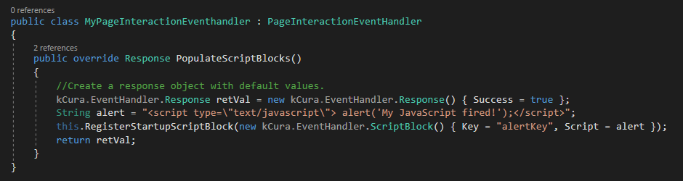
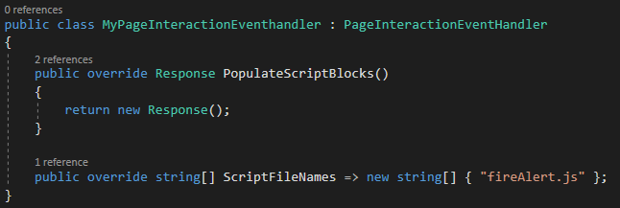
PageInteractionEventHandler Changes:
Classic:
Relativity Forms:
Notes:
Why the change?
We wanted to make it possible for you to keep your "Classic" customization code available if you need to switch it back in production.
The way JavaScript gets linked and executed changes as a result of the new architecture.

Slide 15
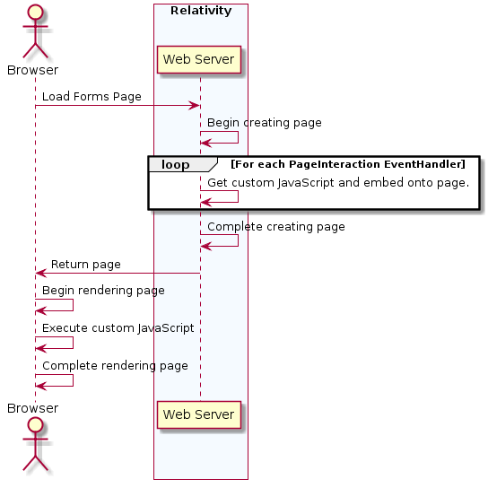
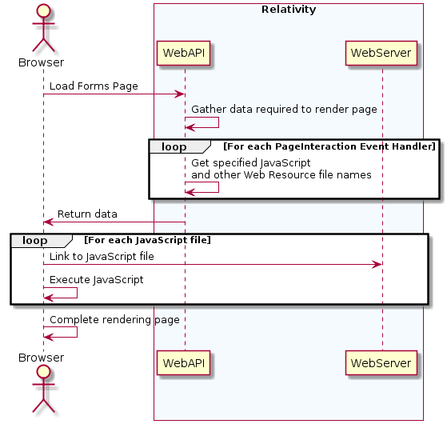
Changes to how JavaScript is loaded
Classic
Relativity Forms
Notes:
CLASSIC
@startuml
actor "Browser" as Browser
box "Relativity" #F5FAFF
participant WebServer as "Web Server"
end box
Browser -> WebServer: Load Forms Page
WebServer -> WebServer: Begin creating page
loop For each PageInteraction EventHandler
WebServer -> WebServer: Get custom JavaScript and embed onto page.
end
WebServer -> WebServer: Complete creating page
WebServer->Browser: Return page
Browser -> Browser: Begin rendering page
Browser -> Browser: Execute custom JavaScript
Browser -> Browser: Complete rendering page
@enduml
FORMS
@startuml
actor "Browser" as Browser
box "Relativity" #F5FAFF
participant WebAPI
participant WebServer
end box
Browser -> WebAPI: Load Forms Page
WebAPI -> WebAPI: Gather data required to render page
loop For each PageInteraction Event Handler
WebAPI -> WebAPI: Get specified JavaScript\nand other Web Resource file names
end
WebAPI->Browser: Return data
loop For each JavaScript file
Browser -> WebServer: Link to JavaScript file
Browser -> Browser: Execute JavaScript
end loop
Browser -> Browser: Complete rendering page
@enduml

Slide 16
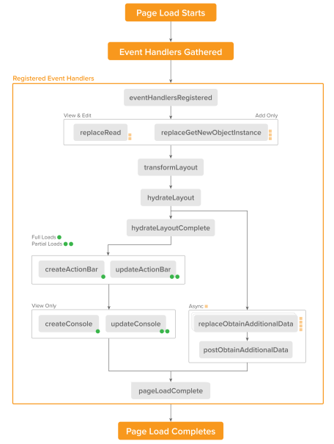
Relativity Forms API
JavaScript API that allows customization of Forms page
Manipulate nearly all the content on the page – categories, fields, consoles, action bar buttons, lists, etc…
Create consoles
Implement common patterns and best practices like calling Kepler services and launching modals.
Well-defined pipelines with over two dozen page-level events that you can hook into

Slide 17
Deeper Into Relativity Forms
Notes:
Main parts of Relativity Forms
Pipelines which comprise much of what you as a developer can tailor
Relativity Forms API, particularly the convenienceApi

Slide 18
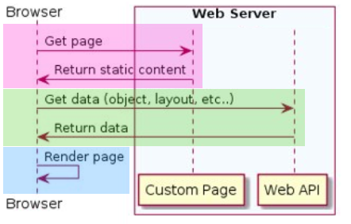
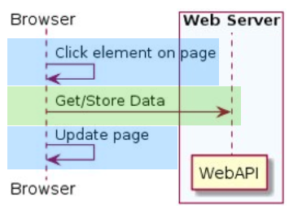
Page Startup
Relativity Forms Application
FormViewModel
Metadata
State
Rendering
PipelineManager
Supply data
Control life cycle
Main Parts of
Relativity Forms
User Activity
Application
PipelineManager
FormViewModel

Slide 19
Load
Full or partial
Change
Response to Field value change
Submit
Create and update
Delete
Current object and child object list items
Item List
Setup columns and actions, handle reload
Pipelines:
The workflows you can tailor
Notes:
Once the type is RF enabled, your event handler script files' purpose is to tailor these pipelines
Change and submit include stock and tailorable client-side validation. Submit validates before submission, and after server response
CRUD entirely overridable

Slide 20
Event-specific parameters
The "this" binding
eventNames
convenienceApi
Relativity Forms API
Notes:
Noteworthy event-specific parameters: layout and object instance data, RF+DOM events, validation state, object version token, operation responses, newly created/updated arifactId, metadata for items to be deleted, list-specific api objects&view metadata
This binding – metadata about the current object and form (mode, artifact id's [workspace, artifact type, artifact, parent and layout], field-id-name-guid mappings), direct access to form data, functions for redirection for errors and page-level error summary

Slide 21
Field and static text manipulation
Markup generators for action bars and consoles
Http client
i18n Internationalization
Stock and custom modals
Relativity Forms and general popup windows
Validation Helpers
Promise factory
And more
Relativity Forms convenienceApi
Notes:
Noteworthy event-specific parameters: layout and object instance data, RF+DOM events, validation state, object version token, operation responses, newly created/updated arifactId, metadata for items to be deleted, list-specific api objects&view metadata

Slide 22
Example
Conversion of a Simple RDO to Relativity Forms

Slide 23
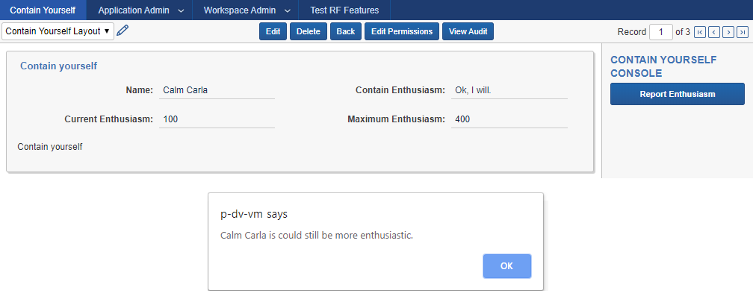
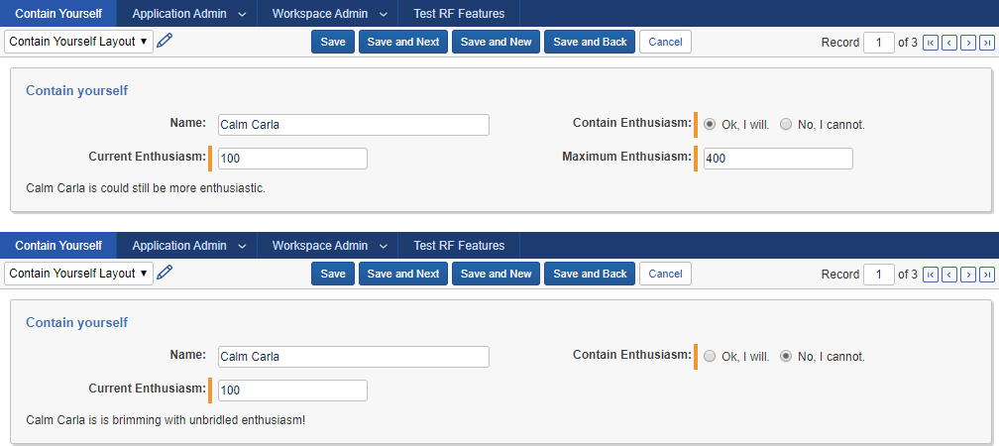
Simple Object Type
View Mode:
PageInteractionEventHandler: One Field shown or hidden based upon another's value JavaScript computing a status summary based upon field values, alters a static text in edit mode. Summary generation shared on window for use in ConsoleEventHandler in View mode
ConsoleEventHandler: Shared summary generation used in an alert fired by the Console button
Edit Mode:

Slide 24
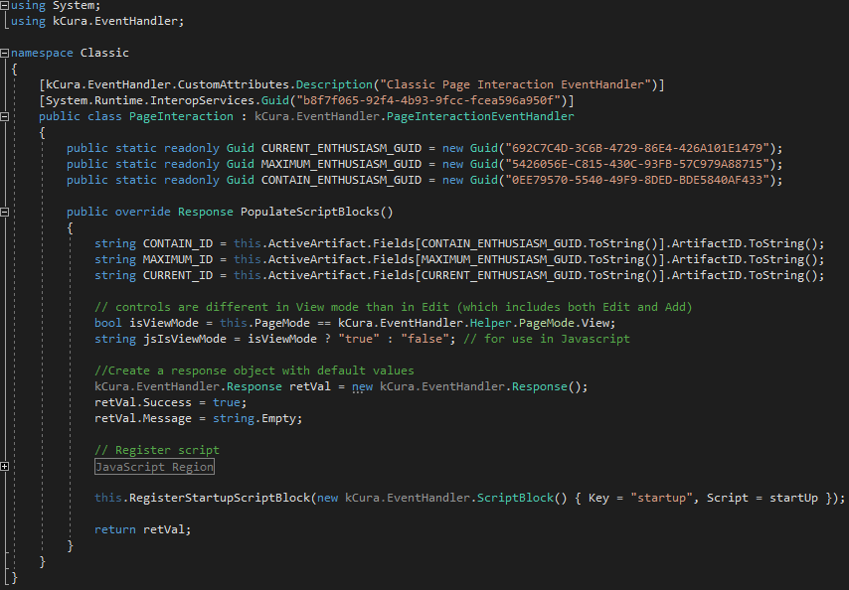
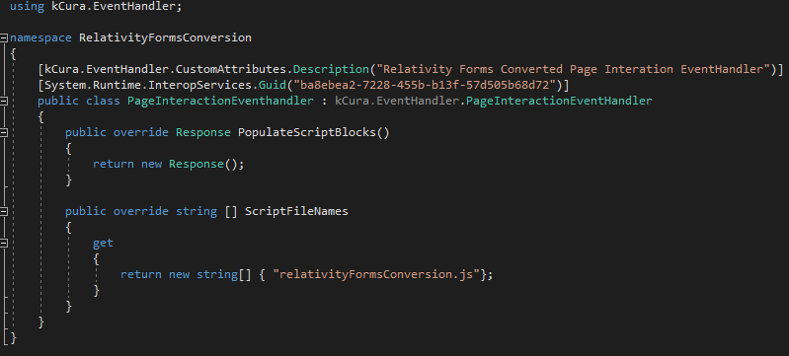
Classic:
Page Interaction
EventHandler
Relativity Forms:
Notes:
NOTE: The Existing Page Interaction Event Handler CAN be modified to override ScriptFileNames for a single .NET event handler capable of either Classic OR Relativity Forms
JavaScript region will be discussed later
Forms image will be shown again, later

Slide 25
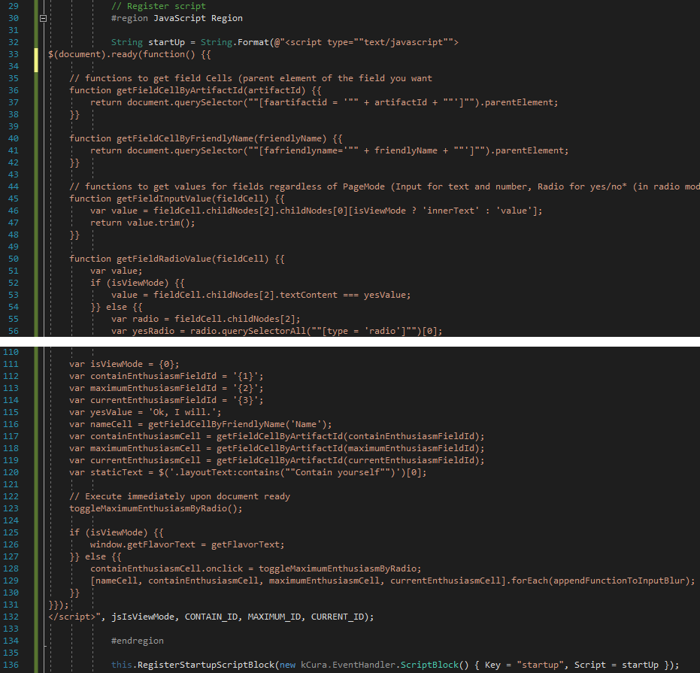
Pain points in Classic:
Classic:
JavaScript as a String in .NET
Fields in the JavaScript
Sharing information between Page Interaction and Console Event Handlers
Notes:
Obtaining fields – injecting artifact ids into script string, unless using friendly names for Fields, which could change
Manipulating them, Getting their values relies on DOM traversal

Slide 26
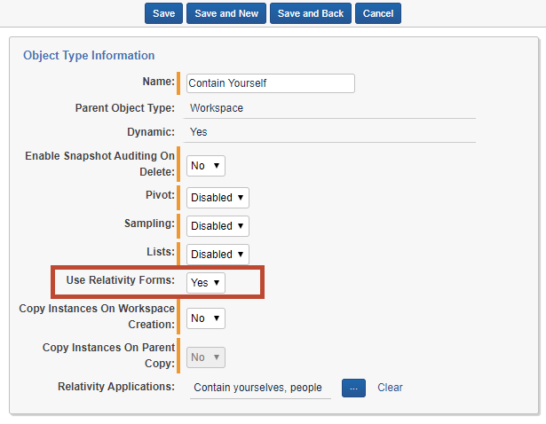
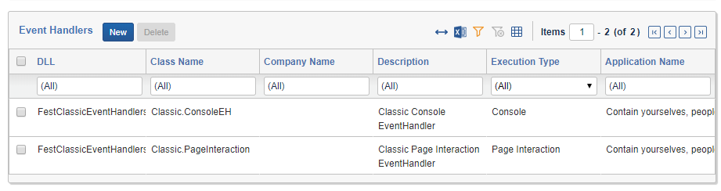
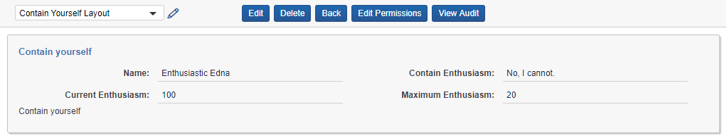
Object Type:
Enable Relativity Forms
Event Handlers:
Event Handlers Not Firing:
Notes:
Handlers are still attached to the Object Type, but no longer fire, as seen by lack of Console, and appearance of "Maximum Enthusiasm" field.
Note how to tell when you're in Relativity Forms vs Classic apart from these handlers not firing (URL) .

Slide 27
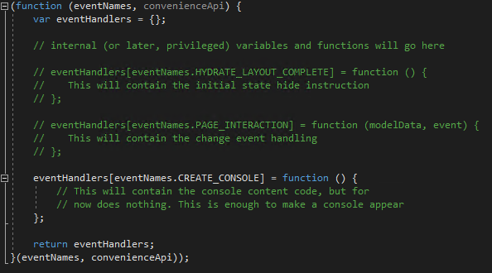
Add Relativity Forms Scripts
PageInteractionEventHandler
New or Updated Page Interaction EventHandler
JavaScript file specified within the EventHandler (only a stub for now)
relativityFormsConversion.js

Slide 28
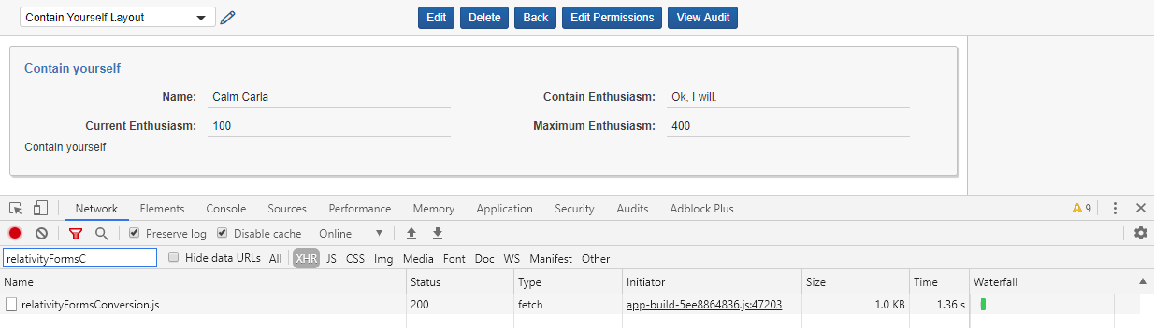
Relativity Forms EventHandler script now being downloaded
Console now appearing on the side
Results

Slide 29
First-class GUID support for Fields
GUIDs can be used directly by Relativity Forms but must be ArtifactID or Friendly Name in Classic
Classic:
Relativity Forms:
Update the JavaScript File: Classic vs Relativity Forms

Slide 30
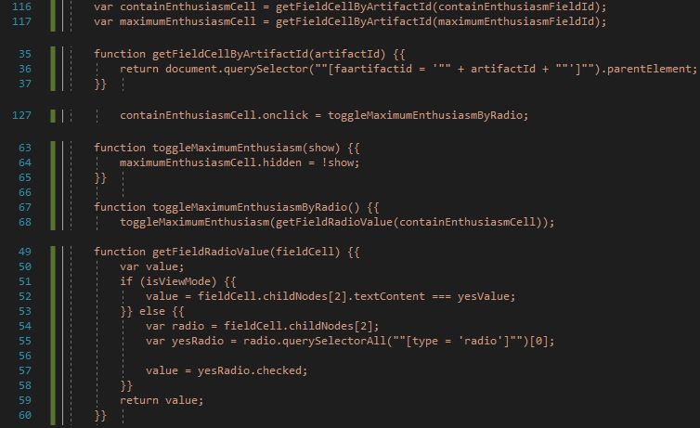
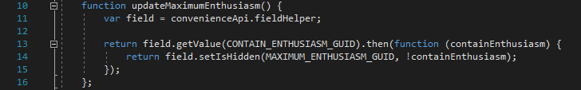
Direct read and manipulation of Field and Static Text
Fields can be read and manipulated without getting the DOM elements; values return in type appropriate to Field
Classic:
Relativity Forms:
Update the JavaScript File: Classic vs Relativity Forms
Notes:
DOM specificity limits the ability to change some aspects of the Layout or Fields. Here, if the value strings for the Yes/No Field change, or if the display type is anything other than radio, the Classic code will break and the event handlers will stop working.
Relativity Forms survives just fine

Slide 31
Form metadata-aware JavaScript
JavaScript handlers are aware of the form mode without injecting it from .NET handlers, or parsing Query String
Classic:
Relativity Forms:
Update the JavaScript File: Classic vs Relativity Forms
Notes:
"this" binding in Relativity Forms knows a lot about the metadata for the Form: mode (by name and id), artifactTypeId, artifactId, layoutId, parentArtifactId, etc.

Slide 32
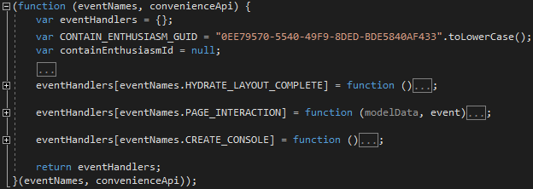
Code Execution Timing
Classic Page Interaction JavaScript fires easily either as the script is interpreted, or once the DOM is loaded; getting finer timing requires manually binding to DOM events
Relativity Forms provides multiple specific extension points within the Load, Change, Submit, and Delete pipelines
Update the JavaScript File: Classic vs Relativity Forms

Slide 33
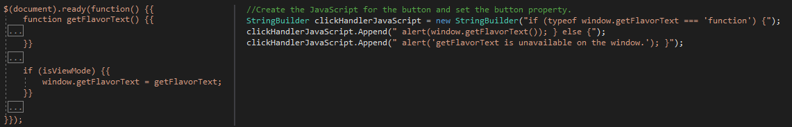
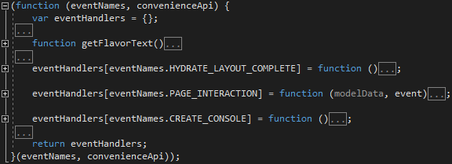
Scope-sheltered JavaScript code sharing by default
Page Interaction and Console EventHandlers are one in the same in Relativity Forms, Console can access what the other handlers can access
Classic:
Relativity Forms:
Update the JavaScript File: Classic vs Relativity Forms
Notes:
Sharing is inclusive of "this" binding information, the convenience api, any private data/functions

Slide 34
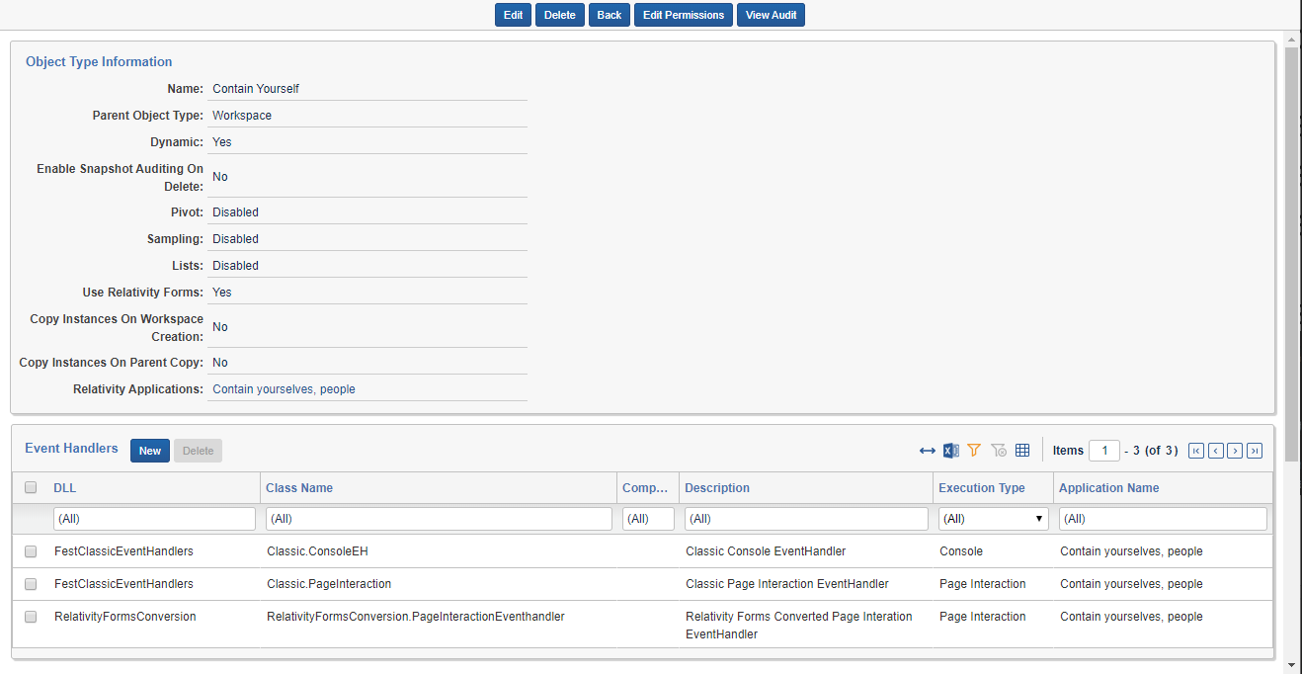
Object Type
Results
Notes:
Relativity Forms is ON.
Classic Event Handlers are still attached, but will not be firing.
Relativity Forms converted PageInteractionEventHandler is attached, and will fire.

Slide 35
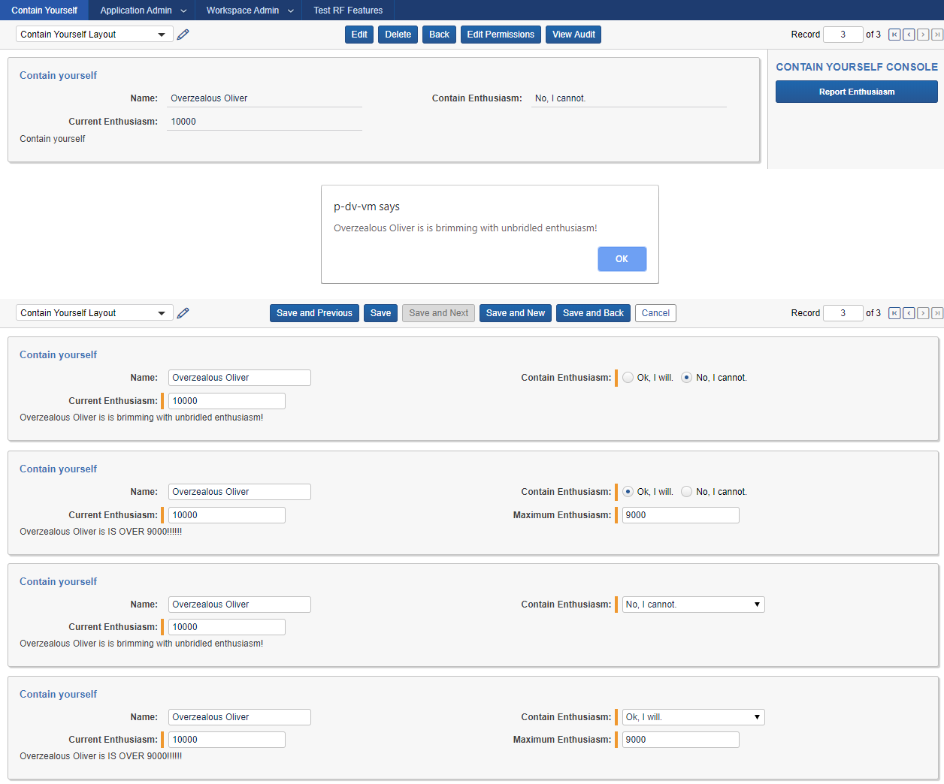
Relativity Forms in action
Results
Notes:
I switched the display type of "Contain Enthusiasm" from radio buttons to dropdown in the last two screenshots.
This causes a break in the Classic event handler script, but continues to work in Relativity Forms

Slide 36
Questions?

Slide 37
Platform Documentation: https://platform.relativity.com/RelativityOne/ Relativity Forms: https://platform.relativity.com/RelativityOne/Content/Relativity_Forms/Relativity_Forms_API.htm
Relativity Forms Cheat Sheet: https://github.com/relativitydev/relativity-forms-workshop-fest-2019/raw/master/docs/workshop/Relativity%20Forms%20Cheat%20Sheet.pdf
DevHelp: https://devhelp.relativity.com/c/relativityui/relativityforms Category: RelativityUI Sub-Category: RelativityForms
Feedback: RelativityFormsFeedback@relativity.com

